Slide 1
Introduction:
Name: Panel Attack
Members: Michael Bailey, Preston Bennett, Matt Clymer, Jordan Fluech, and Alexander Prentice
A head-to-head puzzle game where players match like-colored blocks to beat the other opponent.

Slide 2
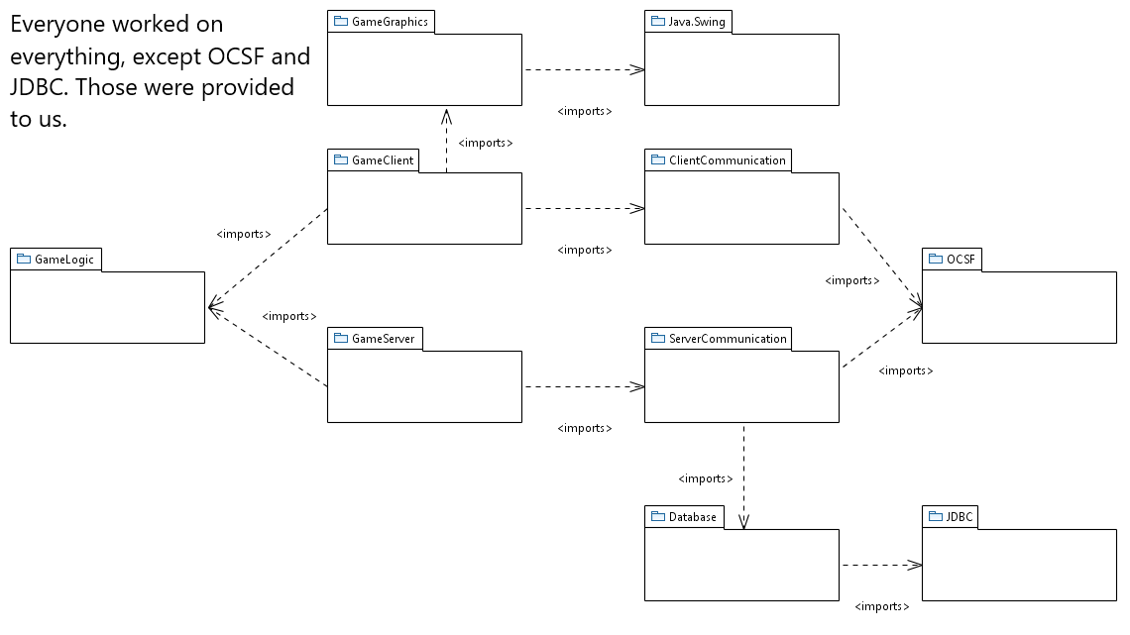
Package Diagram

Slide 3
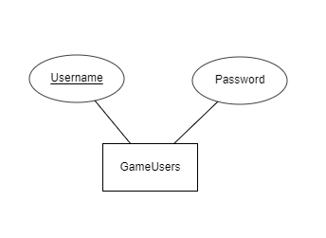
Database Design Diagram

Slide 4
Functional Requirement Example
FailGame - Player loses when block touches top of playing area for a period of time.

Slide 5
Use-Case Description Example
Use Case: FailGame
Actors: Player
Steps:
Player lets one or more blocks touch the top of the play area
The System starts a countdown.
The System determines the Player has lost because the countdown has finished.
The System saves the results of this game.
Both Players are returned to the screen where they can start a new game, view their stats, or logout.
Entry Condition The Player fails to prevent the blocks from the top of their play area and then subsequently fails to remove those blocks from the top of their play area before their opponent loses.
Exit Condition: The game is over, and both players are presented with the game options screen again.

Slide 6
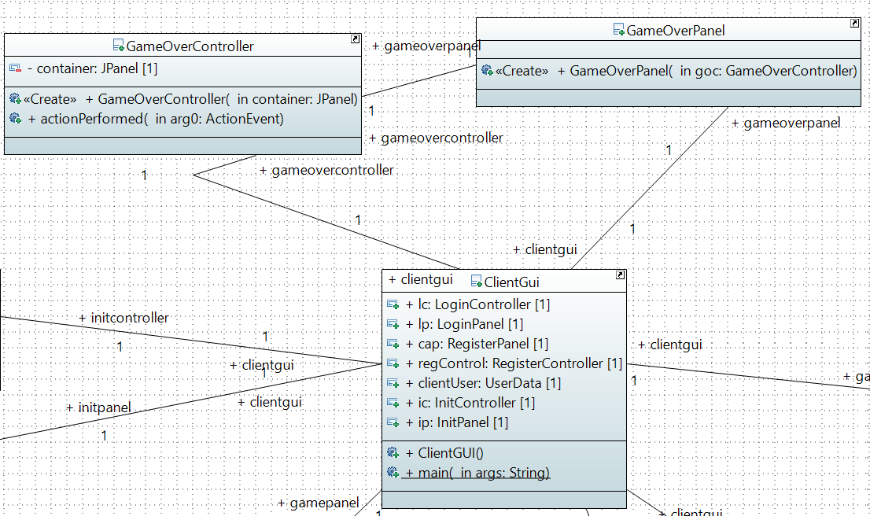
Class Diagram Example

Slide 7
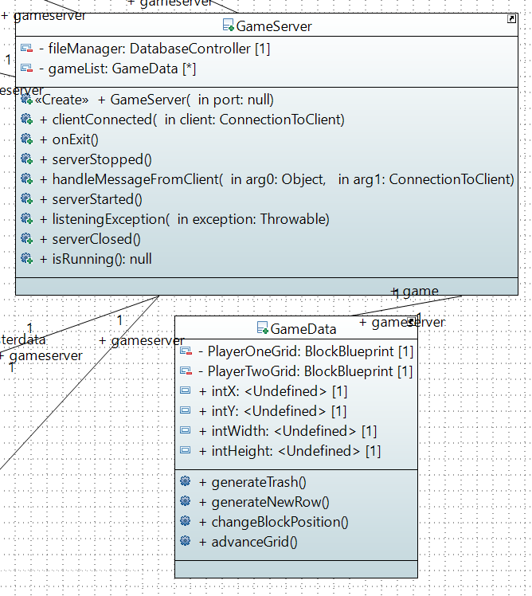
Final Class Diagram

Slide 8
